Slide 1


Food Trends Understanding Customer Preferences in FB
PRESENTED BY
OMKAR DONGARE

Slide 2

PROBLEM STATEMENT
• Businesses need to understand customer feedback
• Large amount of restaurant data available
• Difficult to extract insights manually
• Need for data-driven decision making

Slide 3
PROJECT OBJECTIVE
Analyze restaurant data using Power BI
Perform sentiment analysis
Identify product and customer insights
Support business strategy and innovation

Slide 4
DATASET OVERVIEW
- Attributes Used:
Restaurant Name
Cuisine
Rating
Number of Ratings
Average Price
Location & Area
Pure Veg
Sentiment (created)

Slide 5
DATA COLLECTION AND CLEANING
Imported structured dataset (restaurant data)
Handled missing/null values
Removed duplicates
Created sentiment column using rating logic
Prepared clean dataset for analysis

Slide 6
SENTIMENT ANALYSIS MODULE
• Classified data into:
- Positive
- Neutral
- Negative
• Created measures:
- Positive %
- Negative %
- Sentiment distribution
• Visualized sentiment across restaurants

Slide 7
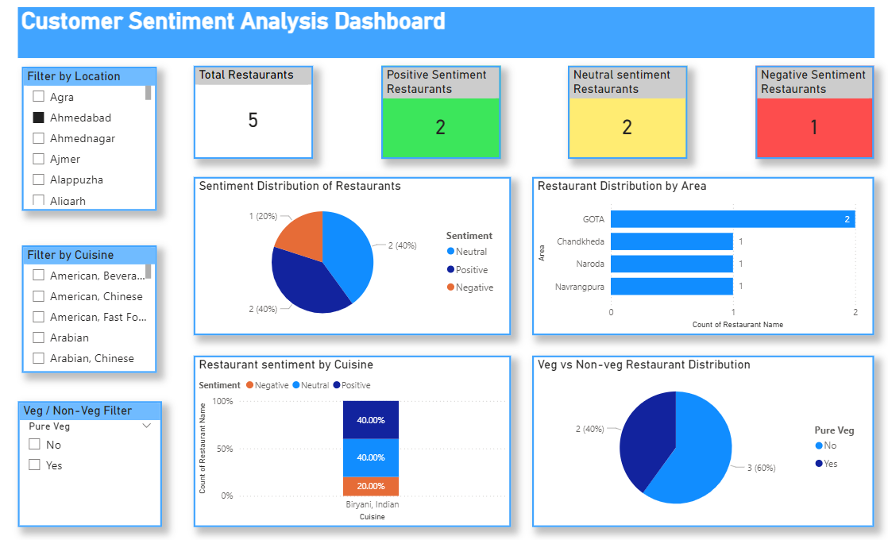
CUSTOMER SENTIMENT DASHBOARD

Slide 8
Product Insights Module
• Compared cuisines based on:
- Rating
- Engagement (Number of Ratings)
• Identified popular food categories
• Analyzed pricing vs customer response

Slide 9
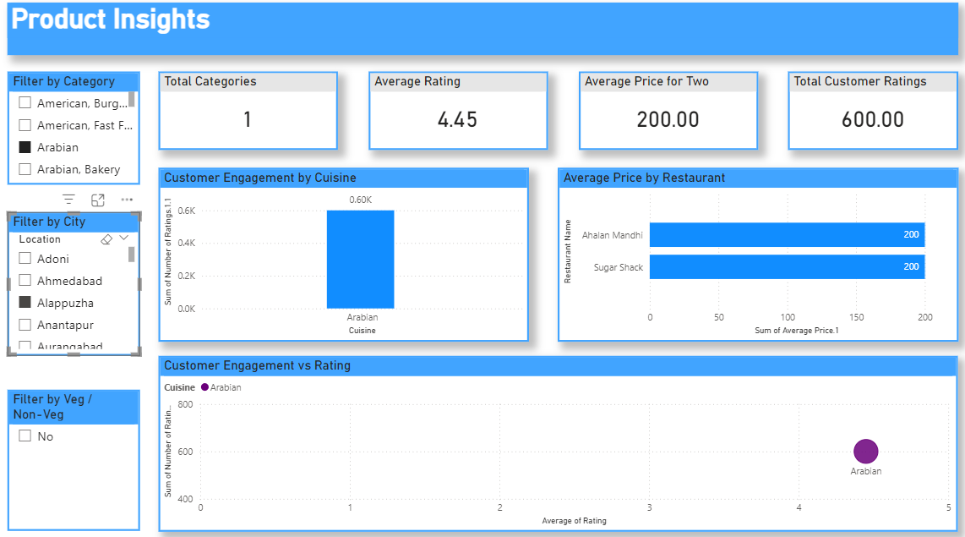
PRODUCT INSIGHTS DASHBOARD

Slide 10
CUSTOMER SEGMENTATION MODULE
Created Personas:
• Loyal Fans → High rating
• Critics → Low rating
• Silent Users → Neutral
• Segmentation based on:
- Rating
- Sentiment
- Engagement

Slide 11
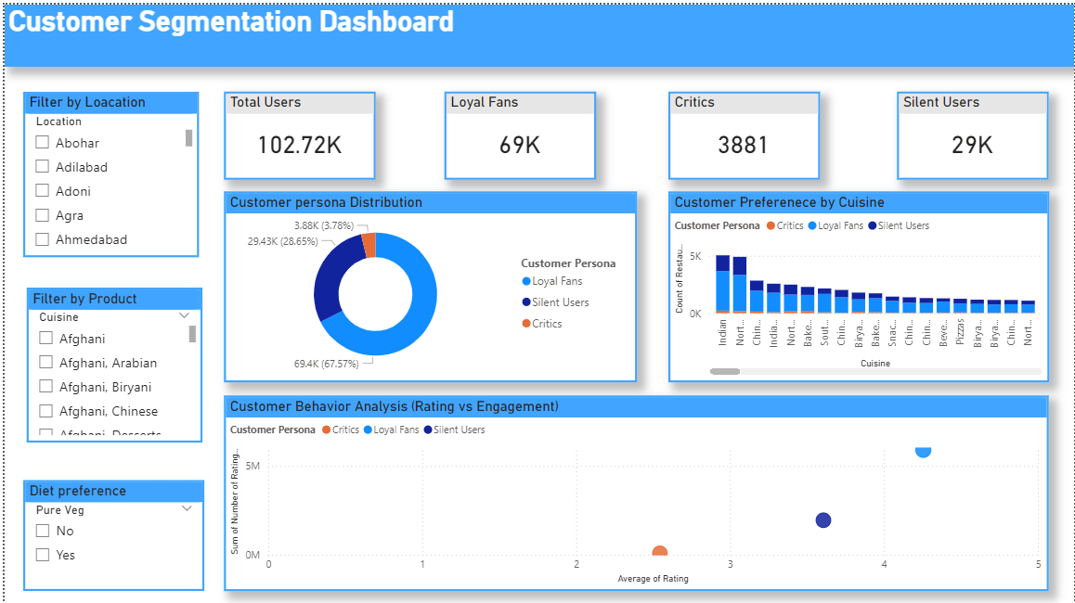
CUSTOMER SEGMENTATION DASHBOARD

Slide 12
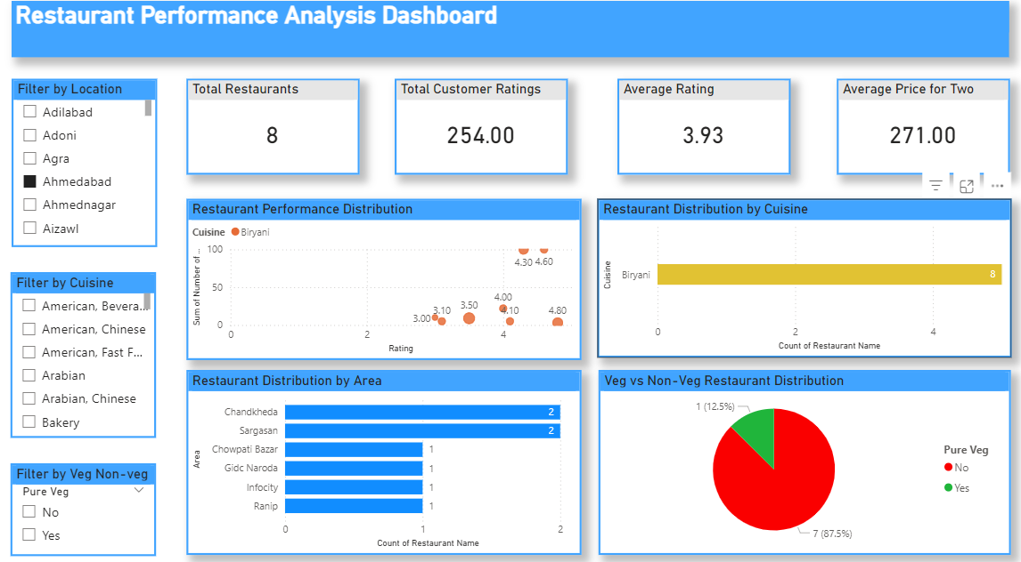
RESTAURANT PERFORMANCE DASHBOARD

Slide 13
STRATEGY & INNOVATION DASHBOARD
• Identified trending cuisines
• Analyzed sentiment trends over time
• Found opportunity areas:
- High demand + low rating
• Used simulated weekly data for trend analysis

Slide 14
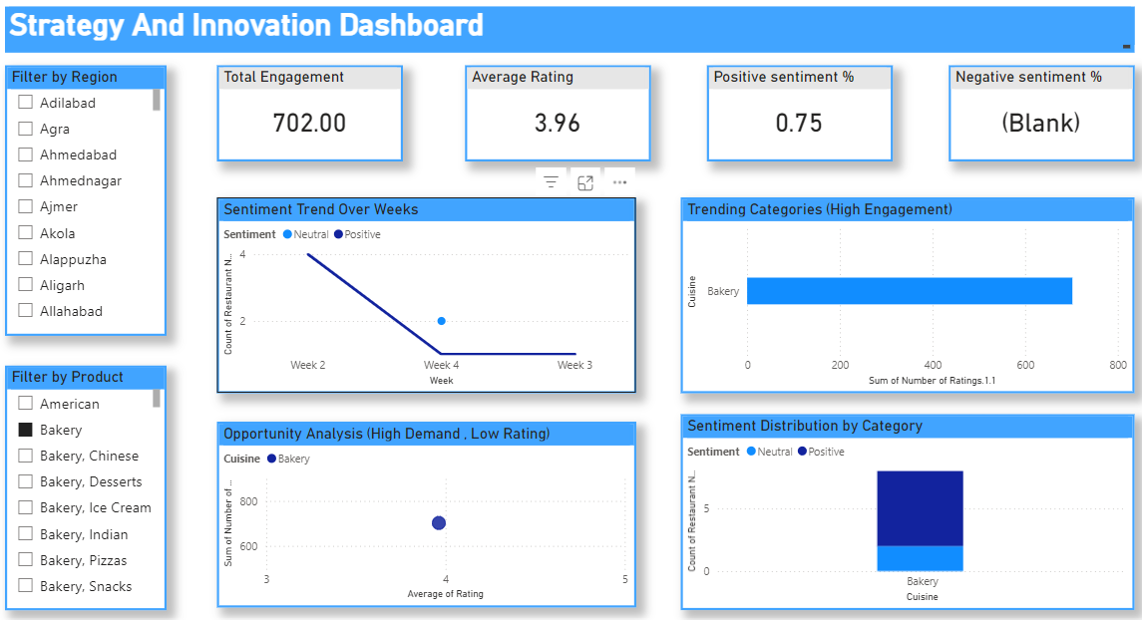
STRATEGY & INNOVATION DASHBOARD

Slide 15
KEY INSIGHTS
Bakery & Fast Food have high engagement
Positive sentiment dominates dataset
Some cuisines need quality improvement
Customer segmentation helps targeted strategies
11

Slide 16
FUTURE SCOPE
• Use real-time data
• Add NLP for real reviews
• Include customer demographics
• Improve recommendation system

Slide 17
CONCLUSION
The project successfully analyzed restaurant data using Power BI
to generate meaningful insights
Sentiment analysis helped in understanding customer satisfaction and overall feedback trends
Product insights identified high-performing cuisines and engagement patterns
Customer segmentation enabled classification of users into Loyal Fans, Critics, and Silent Users for better targeting
The dashboards provide a clear and interactive way to support data-driven decision making in the restaurant industry

